Slide 1
ACADEMIC PATHWAYS: STRATEGIC ON-DRIVE AND OFF-DRIVE PLACEMENT FOR SCHOOL OCCUPATION DIVISIONS AND AFFILIATIONS
PROJECT GUIDE:
Mrs.D.ASHA B.Tech.,M.E.,(Ph.D.,)
TEAM MEMBERS:
Dinesh S - 210921205013
Murugan A - 210921205032
Gokul Prasath H - 210921205017

Slide 2
ABSTRACT:
Campus Recruitment System: This is a web-based comprehensive application that seeks to enhance the efficiency and coverage of placement drives undertaken by institutions of learning. As demand for effective employment solutions for students grows, this portal becomes an essential tool for the administrator and coordinator in recruitment. Application. The app allows administrators to govern the recruitment process. Administrators will have the ability to add coordinators into the system. Coordinators are key leaders that also operate on facilitating placements and, once logged in to the system, can give critical information about the upcoming recruitment drives. Essential details such as company names, relevant departments, and specific requirements can easily be fed by coordinators in order to make the students well-informed about available opportunities. In addition, the system allows administrators to upload different requirements of jobs, thereby catering to on-campus and off-campus placements. This opens the whole horizon of employment opportunities to students. The whole approach has streamlined communication from the colleges towards potential employers and better access to job opportunities for students themselves, thus helping create a more efficient recruitment process. The system shall, through this capitalization of technology, bridge the gap between academia and the industries to contribute towards actual employment of the graduates and strengthening the commitment of this institution towards student success amidst the competitive job market.

Slide 3
INTRODUCTION
Today, campus recruitment has become the necessity of the educational institutions keen on having their students attain meaningful job opportunities. Being aware of this aspect, colleges and universities have been engaging themselves in structured placement drives.
But conducting the placement drive is not an end; instead, it should be streamlined to be accessible so as to achieve mass participation and involvement among the students. This is where the Campus Recruitment System web application comes in.
It is an all-rounded solution for ensuring that the recruitment processes of educational institutions are effectively and promptly managed. The design of the application makes communication of vital information, regarding placement drives going to happen, easy and friendly for the administrators and coordinators.
This system will therefore ensure that accurate information on the opportunities available is communicated to students.
Coordinators will thus be able to input vital information, such as company names, departments where recruitment is allowed, and specific job requirements, which will then be included in the application.
The Campus Recruitment System would make the recruitment process easier and bridge the academic world with the business world, thereby ensuring that students are placed in their jobs successfully.

Slide 4
PROJECT OBJECTIVE
The Campus Recruitment System produces the key objective of creating a streamlined and efficient platform that will enhance the campus recruitment process for educational institutions. This will offer improved communication and coordination between the administrators, coordinators, and the students in regards to the placement drives and job opportunities.
The application is providing the coordinators with an easy input interface and management of details regarding companies, job requirements, and eligible departments for their recruitment drive in an effective way. It also targets that the students will get information at the right time so as to be prepared for the prospective career accordingly.
Furthermore, it bridges the gap between academics and industries since institutions are enabled to advertise both on-campus and off-campus job opportunities.
As a result, the students' employment options expand. And finally, having moved in this direction, the goal would aim to create a conducive recruitment atmosphere, from which recruitment adds value not only to employability but also the reputation that is achieved on both the institute and job market levels, indicating proactive career planning and development within the academic community.

Slide 5
Existing System | Proposed System
placement information is shared manually through notice boards, emails, or WhatsApp groups, leading to limited accessibility. Students often miss out on opportunities due to the lack of a centralized platform. Off-campus placement details are not systematically shared or tracked. This system is inefficient and does not encourage collaboration among students. | In the Proposed system with this application, every student in the college and another college students will access the application by username and password and he can see the information of all placements and if any of other students will upload the placements outside college they can also view the placements..
Techniques: Whatsapp ,Spreadsheet, email | Techniques: SQL operation, Data Mining, AWS
Demerits: 1.Placement information is scattered across emails, messaging apps, and notice boards, making it hard for students to track opportunities effectively. 2. There is no structured way for students to share off-campus placement details, leading to missed opportunities and inefficiency. | Merits: This web application is user friendly and user can access its way to easily. The placement management system process is use to monitoring the student information and allocated the students placement interview. The information of all the students can be stored. CV’s are categorized according to various streams. Various companies can access the information. Students can maintain their information and can update it. Students can access previous information about placement.

Slide 6
LITERATURE SURVEY
TITLE: A blended learning model based on smart learning environment to improve college students' information literacy
AUTHOR: Yong Shi1,2,,Fei Peng 1 ,Fang Sun 3
YEAR: 2022
DESCRIPTION:
Under the pandemic, improving college students' information literacy has become crucial. This paper introduces the first model for enhancing information literacy based on a smart learning environment. Using the CIAP framework (Conceptual, Intelligent, Action, and Process levels), the authors propose a blended learning model with six strategies: expanding resources, creating intelligent environments, clarifying interactive activities, promoting mutual learning, timely feedback, and optimizing evaluation. Experiments with engineering students in a Chinese university showed significant improvements in the experimental group, proving the model's effectiveness. This study highlights the sustainable development of information literacy through smart learning environments.

Slide 7
TITLE: Evidence for large long-term memory capacities in baboons and pigeons and its implications for learning and the evolution of cognition
AUTHOR: Joe¨l Fagot† and Robert G. Cook‡
YEAR: 2010.
DESCRIPTION:
Previous research has shown that birds and primates have a rich repertoire of behavioral and cognitive skills, but the mechanisms underlying these abilities are not well understood. A common hypothesis is that these adaptations are mediated by an efficient long-term memory, allowing animals to remember specific external events and associate appropriate behaviors to these events. Because earlier studies have not sufficiently challenged memory capacity in animals, our comparative research examined with equivalent procedures the size and mechanisms of long-term memory in baboons and pigeons. Findings revealed very large, but different, capacities in both species to learn and remember picture– response associations. Pigeons could maximally memorize between 800 and 1,200 picture–response associations before reaching the limit of their performance. In contrast, baboons minimally memorized 3,500–5,000 items and had not reached their limit after more than 3 years of testing. No differences were detected in how these associations were retained or otherwise processed by these species. These results demonstrate that pigeons and monkeys have sufficient memory resources to develop memory-based exemplar or feature learning strategies in many test situations. They further suggest that the evolution of cognition and behavior importantly may have involved the gradual enlargement of the long-term memory capacities of the brain.

Slide 8
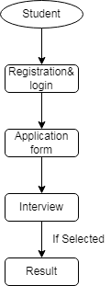
Modules
1. Student
1.1 Application Form
1.2 Interview
1.3 Result View

Slide 9
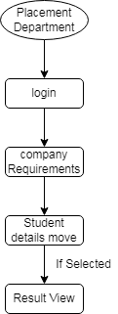
2. Placement Department
2.1 Company Requirement
2.2 Student Details-Interview
2.3 Result View

Slide 10

3. Company
3.1 Requirement
3.2 Student Details
3.3 Interview Conduction
3.4 Result View (Selected)

Slide 11
ALGORITHM USED:
The AES algorithm (also known as the Rijndael algorithm) is a symmetrical block cipher algorithm that takes plain text in blocks of 128 bits and converts them to cipher text using keys of 128, 192, and 256 bits. Since the AES algorithm is considered secure, it is in the worldwide standard.
How does AES work?
The AES algorithm uses a substitution-permutation, or SP network, with multiple rounds to produce cipher text. The number of rounds depends on the key size being used. A 128-bit key size dictates ten rounds, a 192-bit key size dictates 12 rounds, and a 256-bit key size has 14 rounds. Each of these rounds requires a round key, but since only one key is inputted into the algorithm, this key needs to be expanded to get keys for each round, including round 0.

Slide 12
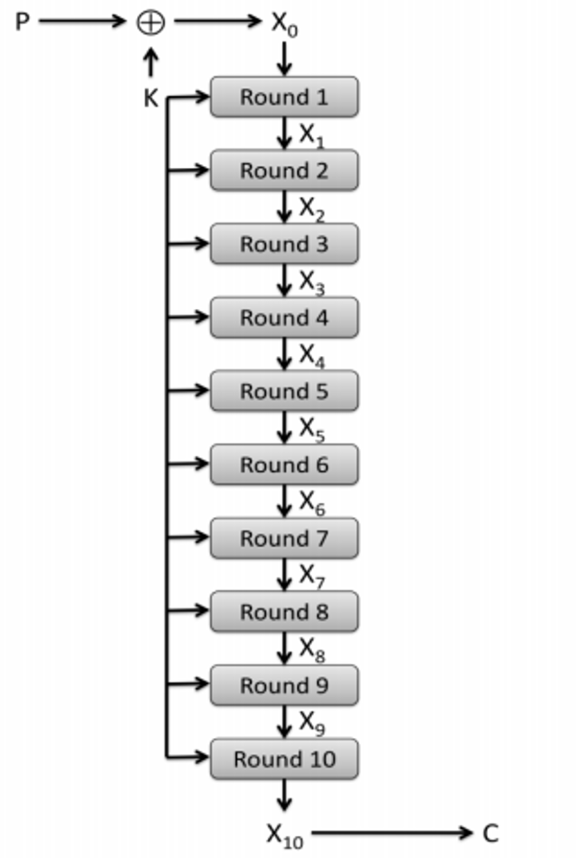

Slide 13
AWS ELASTIC BEANSTALK
Deploying Placement portal website using AWS Elastic Beanstalk provides a scalable and efficient infrastructure for managing placements. This project requires a reliable backend to process student applications, job postings, and placement records while integrating with a user-friendly frontend for seamless interaction.
AWS Elastic Beanstalk simplifies deployment by automatically managing server configurations, scaling, and monitoring. The backend, built using Node.js, Python, or Java, can be deployed as an Elastic Beanstalk application, connecting to an AWS RDS database for secure storage of student and company data.
The frontend, developed using React.js, can either be hosted on Elastic Beanstalk or deployed separately on AWS S3 with CloudFront for fast content delivery. AWS services like S3 enable the storage of resumes and offer letters, while AWS SNS or SES can be used for placement notifications.
By leveraging auto-scaling and load balancing, the system ensures high availability and performance even during peak placement seasons. Additionally, AWS CloudWatch allows real-time monitoring of application performance, ensuring smooth operations.
With AWS Elastic Beanstalk handling infrastructure management, the development team can focus on enhancing user experience and refining placement strategies without worrying about deployment complexities.

Slide 14
REQUIREMENTS ENGINEERING
3.1 GENERAL:
These are the requirements for doing the project. Without using these tools and software’s we can’t do the project. So we have two requirements to do the project. They are
1. Hardware Requirements.
2. Software Requirements.

Slide 15
HARDWARE REQUIREMENTS:
The hardware requirements may serve as the basis for a contract for the implementation of the system and should therefore be a complete and consistent specification of the whole system. They are used by software engineers as the starting point for the system design. It shows what the system does and not how it should be implemented.
PROCESSOR : PENTIUM IV 2.6 GHz, Intel Core 2 Duo.
RAM : 4GB DD RAM
MONITOR : 15” COLOR
HARD DISK : 40 GB

Slide 16
SOFTWARE REQUIREMENTS:
The software requirements document is the specification of the system. It should include both a definition and a specification of requirements. It is a set of what the system should do rather than how it should do it. The software requirements provide a basis for creating the software requirements specification. It is useful in estimating cost, planning team activities, performing tasks and tracking the team’s and tracking the team’s progress throughout the development activity.
Front End : J2EE (JSP, SERVLETS) JAVASCRIPT
Back End : MY SQL 5.5
Operating System : Windows 07
IDE : Eclipse

Slide 17
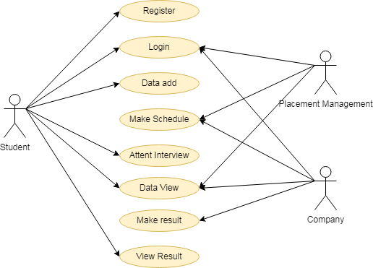
DESIGN ENGINEERING
Use Case:

Slide 18
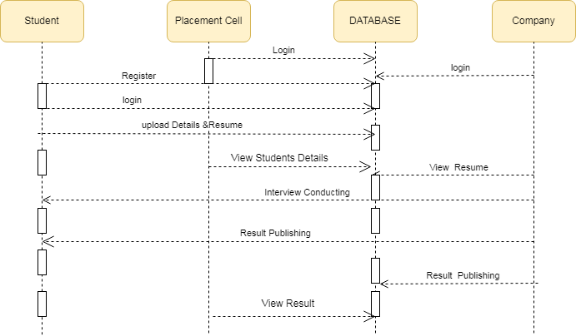
Sequence Diagram:

Slide 19
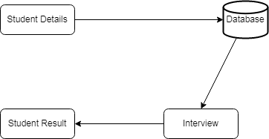
Object Diagram:

Slide 20

State Diagram:

Slide 21
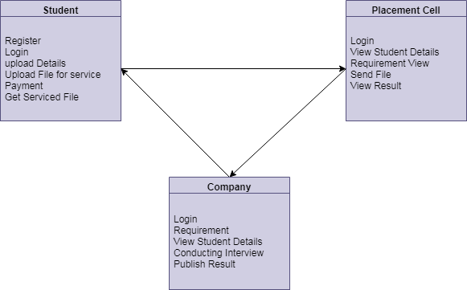
Class Diagram

Slide 22
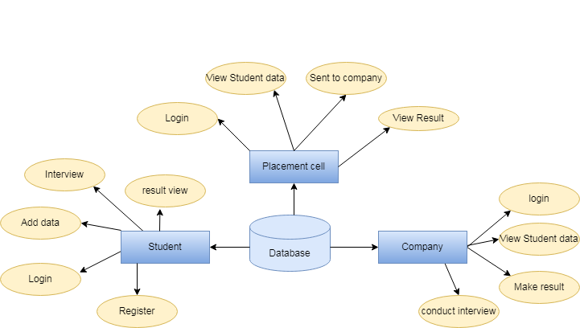
E-R Diagram:

Slide 23
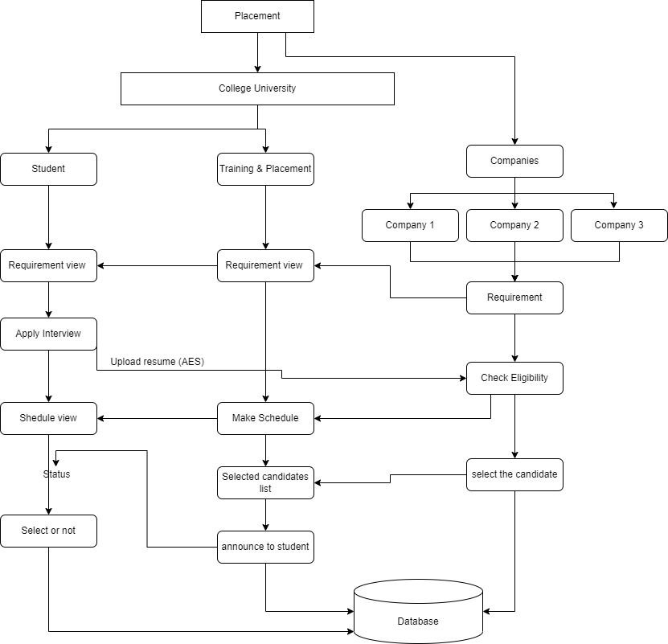
SYSTEM ARCHITECHTURE

Slide 24
CONCLUSION:
Campus Recruitment System is the biggest step forward in the mode of management and execution of placement drives by educational institutions.
The system presents a single-portal platform that ensures proper communication and coordination among administrators, coordinators, and students in a most effective manner to not just automate the recruitment process but also to better engage and prepare the students for the markets.
With the ability to manage both on-campus and off-campus opportunities, the application widens the students' horizons to find available jobs in all possible settings.
Further, after equipping the integration of data analytics, the institutions will be able to assess their recruitment strategy very effectively; hence they can continue improving and adapting other requirements of the industries.
Finally, the Campus Recruitment System plays a vital role as a bridge between academic and professional environments, thereby contributing to the successful transition of students into an increasingly competitive job market and reinforcing the commitment of educational institutions to fostering student success and employability.

Slide 25
THANK YOU

